Slide 1
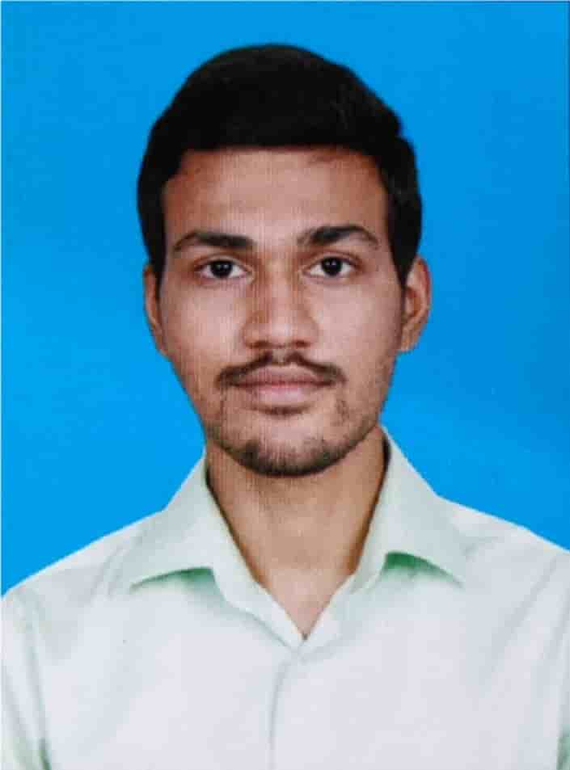

Name: Shawn Abraham, SkillsBuild Email ID: shawnabraham@karunya.edu.in College Name: Karunya Institute of Technology and Sciences College State: Coimbatore, Tamil Nadu - 64114
Internship Domain: Artificial Intelligence (AI)
Internship Duration: 12-06-2023 to 24-07-2023 (6 Weeks)

Slide 2


Mental Health Fitness Tracker
Mental Well-Being
Wealth
Health
Problem Statement:
The project arms to develop an Al Mental Fitness Tracker using different machine learning algorithms. By doing so, the Al Mental Fitness Tracker will predict an individual's mental well-being, providing personalized insights and recommendations to help users monitor and improve their mental fitness over time.

Slide 3
AGENDA
STEP 1: Importing necessary libraries and Data Collection.
STEP 2: Read the Datasets and merge them into a Data Frame.
STEP 3: Data Cleaning, which involves either removal or imputation of null values.
STEP 4: Exploratory Data Analysis, which involves checking for trends, patterns, as well as anomalies and outliers.
STEP 5: Data Preprocessing, which involves selecting apt features and targets, as well as splitting the Data Frame.
STEP 6: Fit the Linear Regression Model and evaluate its performance on training and testing sets.
STEP 7: Fit the Random Forest Regressor Model and evaluate its performance on training and testing sets.
Step 8: Fit Other Regression Models and evaluate their performance on training and testing sets.
Step 9: Decide on a Optimum model for predicting results on user inputs.
Step 10: Make a program that takes in User Input and predicts Disability-Adjusted Life Years(Loss in Life Expectancy).

Slide 4



PROJECT OVERVIEW
The Mental Health Fitness Tracker project aims to develop an Al-driven solution for analysing and predicting mental fitness levels of individuals with various mental disorders.
﻿﻿The project involves a comprehensive workflow to ensure accurate and insightful results.
﻿﻿It aims to contribute to the field of mental health by providing accurate predictions and valuable insights, leading to better understanding and management of mental disorders.

Slide 5
WHO ARE THE END USERS of this project?
USERS | Mental Health Seekers | Mental Health Professionals | Academicians and Researchers | HealthCare Sector
Characteristics | Different Age Groups and Diversity | Psychologists, counselors who aid & support people with Mental Health issues | Scholars who study the broader domain of Mental Health | Hospitals and Health Services are critical & time sensitive.
Needs | Assess their Mental Wellbeing and Seek Improvement | Tools for assessing, & progress tracking of clients. | Research requires good quality data and survey tools. | Their patents need personalized care while being time & cost effective
Benefit from Solution | Gives them score of DALY and scope of Improvement | Provides interactive data-driven Insights | It can improve user surveys and provide high quality data | It can complement mental health services thus improve patient diagnostics.

Slide 6



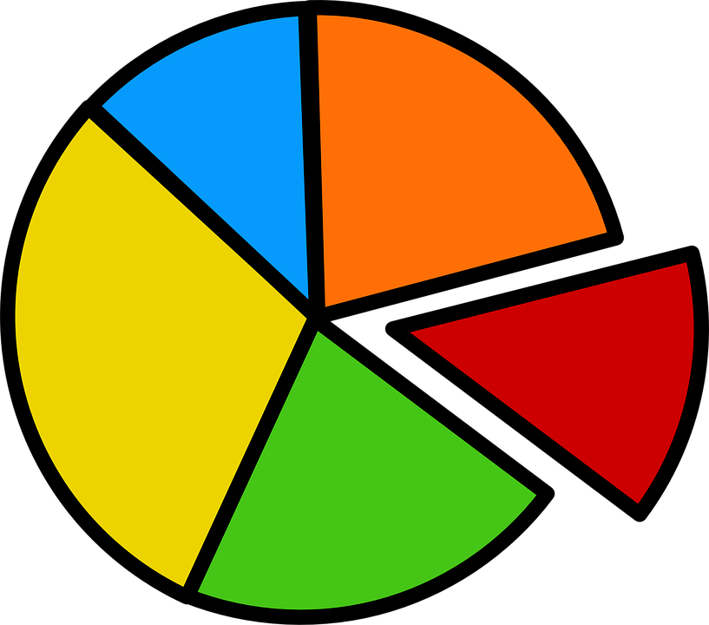
YOUR SOLUTION AND ITS VALUE PROPOSITION
Insightful Analysis: Our solution utilizes regression techniques to provide basic insights into mental health and make predictions based on available data.
Progress Tracking: Users can monitor their mental health over time and observe any changes or trends, allowing them to take proactive steps towards self-improvement.
Healthy Discourse: Emphasize the importance of respectful and inclusive dialogue to cultivate a community focused on promoting mental wellness.
Educational Experience: Learn the fundamentals of data analysis and implement various regression techniques, enhancing understanding of the subject matter

Slide 7

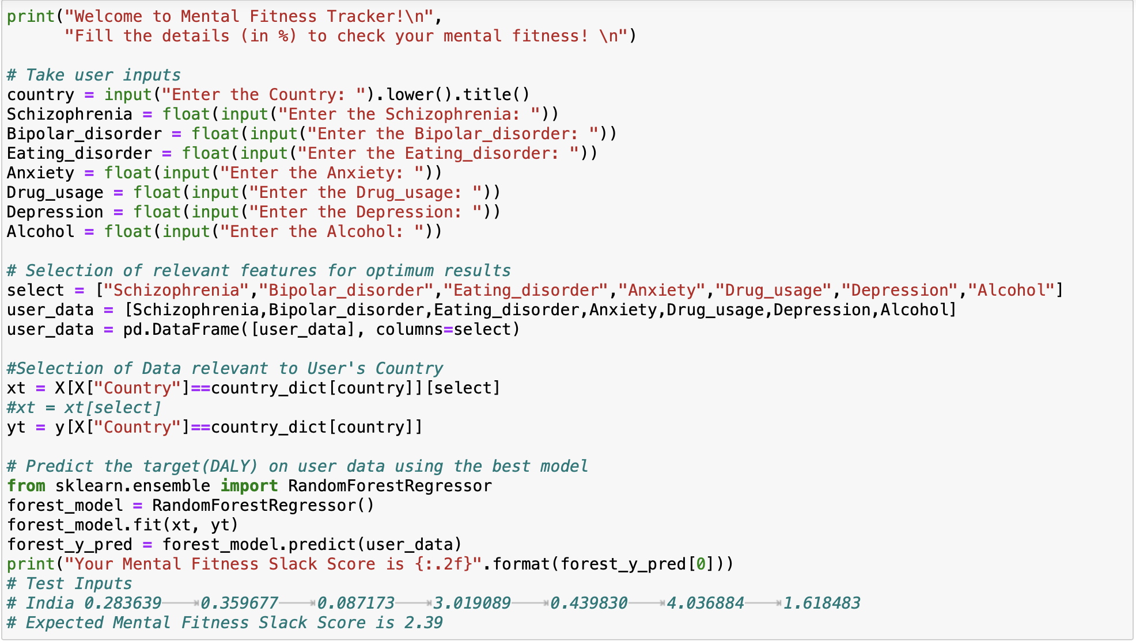
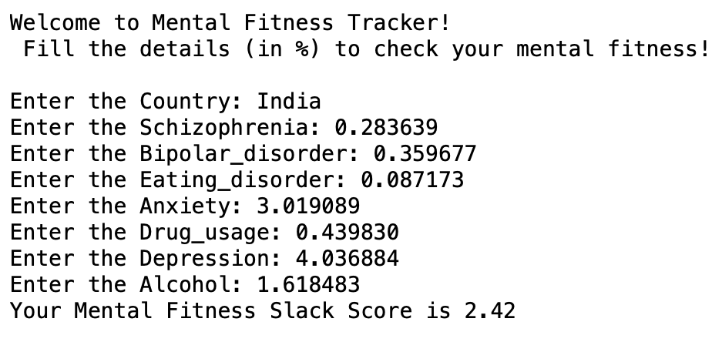
How did I customize My project and make it your own
Datasets used:
mental-and-substance-use-as-share-of-disease.csv
﻿prevalence-by-mental-and-substance-use-disorder.csv
Mental Health
Introducing My New Mental Fitness Slack Tracker
is
Wealth

Slide 8
MODELLING
In the Modelling phase, we aim to predict Disability-Adjusted Life Years (DALYs) caused by mental disorders using various regression algorithms.
Machine Learning (Regression) Algorithms used:
Ridge Regression
﻿﻿Lasso Regression
Elastic Net Regression
Polynomial Regression
Decision Tree Regression
Random Forest Regression
Support Vector Regression
XGBoost Regression
• K-Nearest Neighbours Regression
﻿﻿﻿Bayesian Regression
﻿﻿﻿Neural Network Regression
﻿﻿﻿Gradient Boosting Regression

Slide 9
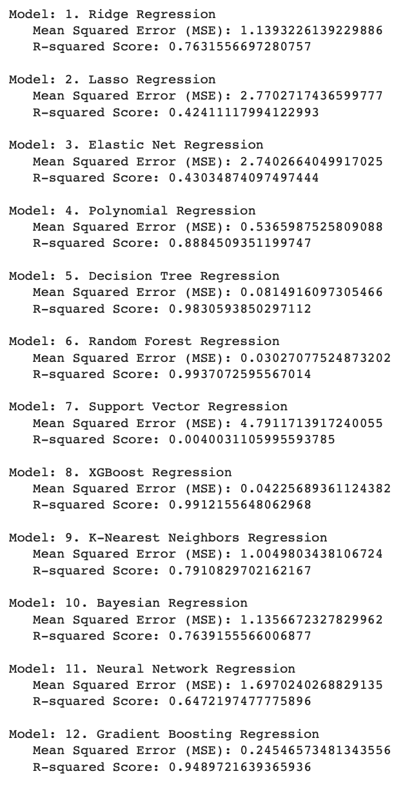
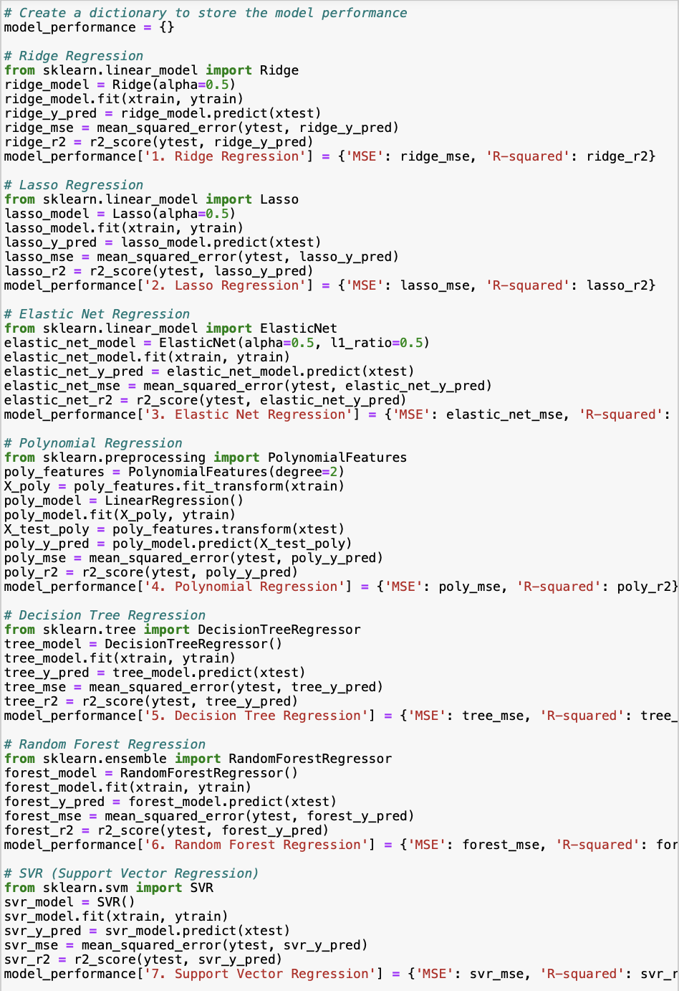
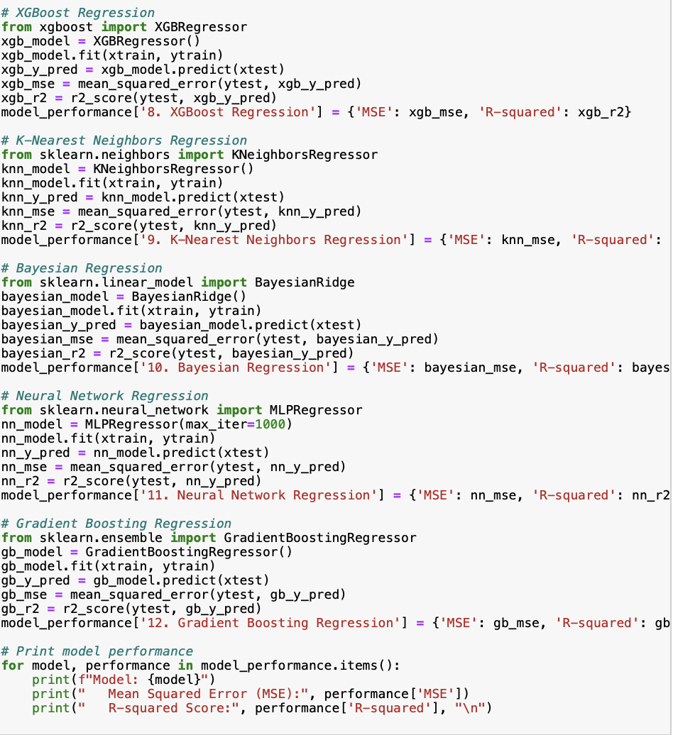
Regression MODELS Evaluation
The Best Model is Random Forest Regression with MSE = 0.030 and R2 Score = 0.994

Slide 10
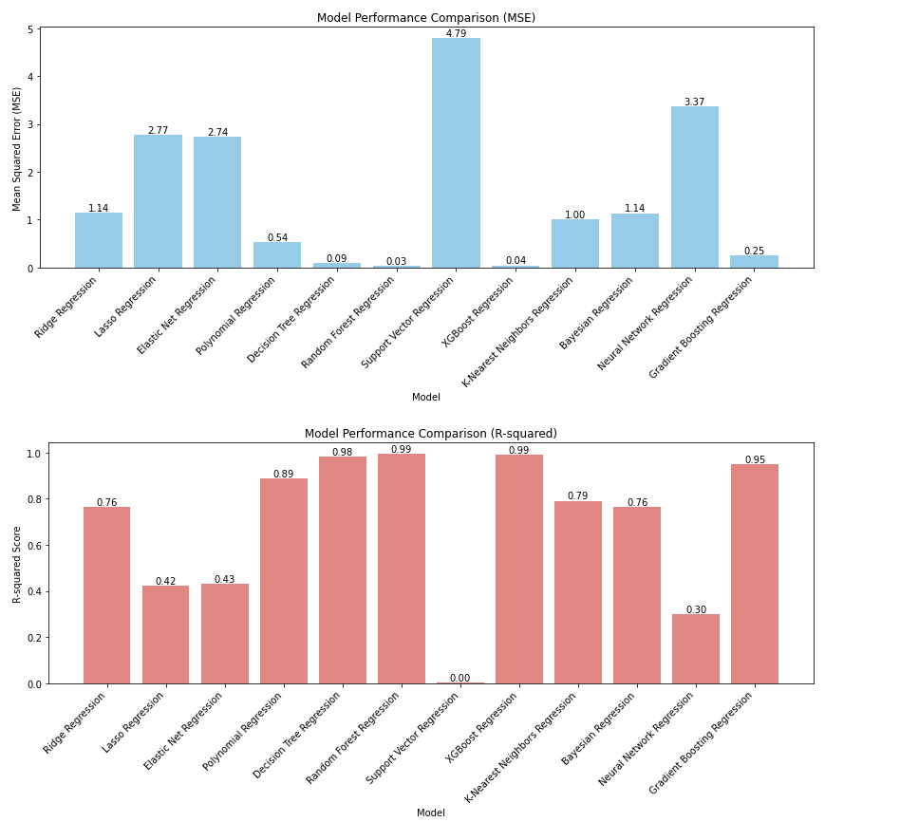
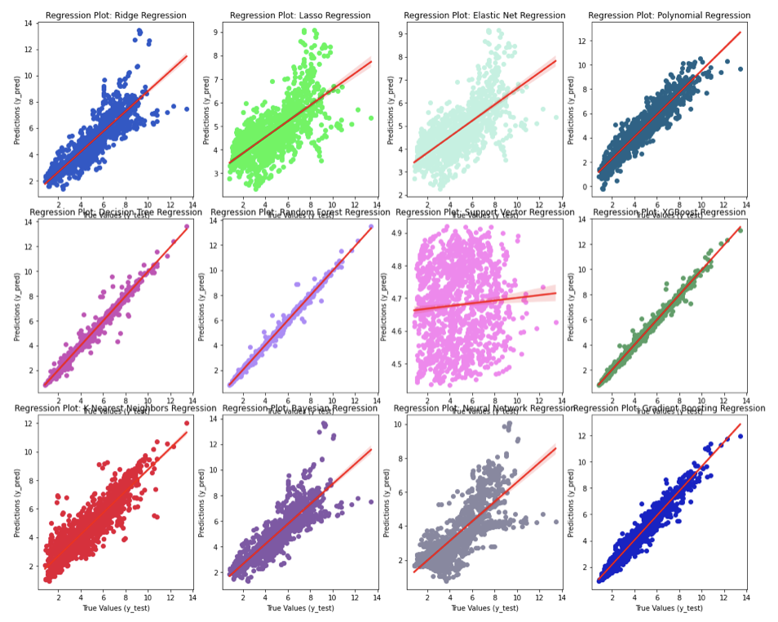
Results

Slide 11
links
Github:
https://github.com/URK20CS3026SHAWN/IBM_AI_Mental_Health_Tracker
References:
https://skillsbuild.edunetworld.com/courses/ai/mental-fitness-tracker/
https://www.kaggle.com/code/kanuriviveknag/ai-mental-fitness-tracker

Slide 12
Made By Shawn Abraham
Thank You

